Slide 1
BT 601: Analytical Biotechnology
-Prof. Siddhartha Sankar Ghosh
Lec-6

Slide 2
Transport Device

Slide 3
Schematic of Nanotransport Device

Slide 4
Φ29 DNA polymerase is an enzyme from the bacteriophage Φ29. It is being increasingly used in molecular biology for multiple displacement DNA amplification procedures, and has a number of features that make it particularly suitable for this application.
The principal idea behind the device is strong strand displacement ability of Φ29, which can displace any DNA strand from its template while extending a primer hybridized to the template.
The major advantage is its speed. It can travel at the rate of 2000 nucleotides per minute at room temperature, which translates to approximately 680 nm min-1 on a nanostructure.

Slide 5
Overview of the complete setup assembly of polymerase based nanotransportation device

Slide 6
Gel Electrophoresis

Slide 7
(a) that the cargo is not dislodged from the wheel W

Slide 8
The fluorescence remains quenched even after the activity of the polymerase φ29, which indicates that the cargo is not dislodged from the wheel W.

Slide 9
(b) that the wheel and the cargo move from their initial positions.

Slide 10
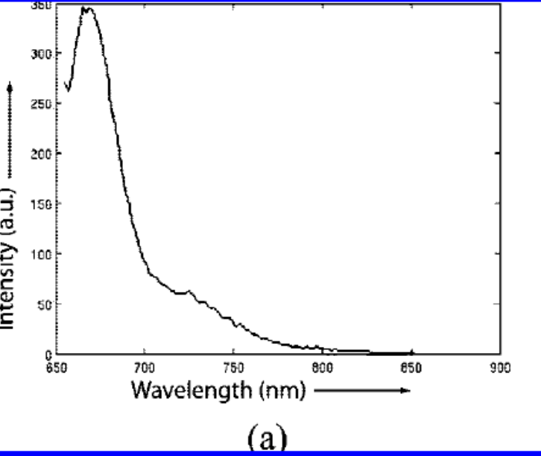
The fluorescence shown by the assembly in the absence of the cargo containing the quencher

Slide 11
that the wheel and the cargo reach the final desired position

Slide 12
The fluorescence quenched by the assembly of cargo containing the quencher.

Slide 13
DNA Oragami
A schematic showing a programmable arbitrary track laid on top of an addressable two-dimensional nanostructure from DNA origami (gray surface).
The dangler strands are shown using thin lines, and they have free ends that protrude out of the nanostructure.

Slide 14
General principles of cell communication

Slide 15
A simple intracellular signaling pathway activated by an extracellular signal molecule.
The signal molecule usually binds to a receptor protein that is embedded in the plasma membrane of the target cell. The receptor activates one or more intracellular signaling pathways, involving a series of signaling proteins. Finally, one or more of the intracellular signaling proteins alters the activity of effector proteins and thereby the behavior of the cell.

Slide 16
THANK YOU

